Slide 1



AI-Driven Driver Monitoring System with AR Heads-Up Display
A Real-Time Solution to Prevent Accidents
Name : Shaili Sahu

Slide 2
TABLE OF CONTENTS
01
02
03
04
05
Problem Statement, Solution Overview, Project Objectives
INTRODUCTION
SYSTEM ARCHITECTURE
Data Acquisition, Feature Extraction, Model
RESULTS AND PERFORMANCE
Model Evaluation, System Latency, User Feedback
FUTURE WORK AND CHALLENGES
Potential Improvements, Challenges Faced
CONCLUSION
Key Contributions, Impact, Call to Action
Name : Shaili Sahu

Slide 3


Introduction
Problem Statement:
Driver fatigue and distraction are leading causes of road accidents.
Traditional methods of monitoring driver behavior are often ineffective.
Solution Overview: AI-powered system aims to address this issue by:
Real-time monitoring of driver's facial expressions and eye movements.
Detecting signs of fatigue, distraction, or drowsiness.
Triggering alerts to warn the driver or activate safety features.
Project Objectives:
Develop a robust and accurate AI model for driver state detection.
Design a user-friendly interface to display real-time alerts.
Evaluate the system's performance in real-world scenarios.
Name : Shaili Sahu

Slide 4
System Architecture
System Components:
Webcam Input: Captures real-time video stream for processing.
Face Detection Module: Identifies and tracks faces in the video stream using Haar cascades or another trained model.
Eye Detection Module: Detects eyes within the identified face region and tracks their status (open/closed).
Position Detection Module: Determines the position of the face (Left, Right, Middle) based on its coordinates in the frame.
Blink Detection Module: Counts blinks by analyzing the transitions between open and closed eye states.
Alert Module: Triggers alerts based on predefined conditions like:
Eyes closed for a prolonged duration.
Face position remaining in "Left" or "Right" zones for a set time.
User Feedback Interface: Displays the processed information such as blinks, position, and alerts on the screen with visual cues.

Slide 5
Hardware Components:
Camera: Captures real-time video feed of the driver.
Processing Unit: Computer or embedded device to run the AI model.
Software Components:
OpenCV Library: Used for real-time computer vision tasks, including face and eye detection.
Haar Cascade Classifier : Pre-trained model for detecting faces and eyes in the video stream.
Python Programming : Core language for implementing the logic, including video stream handling, detection, and alert mechanisms.
Base64 Encoding : Converts processed frames to a format suitable for displaying in web-based or GUI interfaces.
Alert Logic Module : Implements threshold-based checks for eye closure duration, face absence, and position-based triggers.
Name : Shaili Sahu

Slide 6
Data Flow Diagram (DFD) :
Input: Real-time video stream captured from the webcam.
Processing: Frames are preprocessed (grayscale conversion), followed by face, eye, blink, and position detection.
Alert Logic: Thresholds are checked for prolonged eye closure, face absence, or off-center position to trigger alerts.
Output: Processed frames with overlays displaying blink count, position, and alert notifications are shown to the user.
Feedback Loop: Alerts and feedback continuously update in real-time based on the processed data.
Name : Shaili Sahu

Slide 7
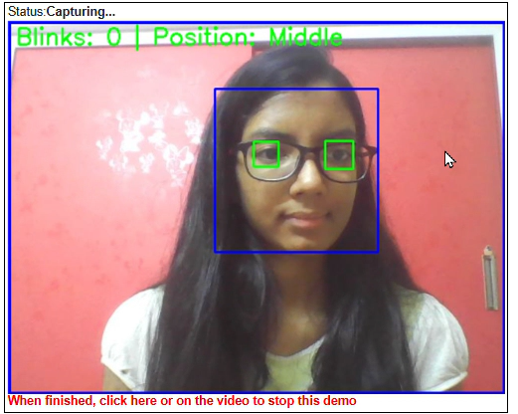
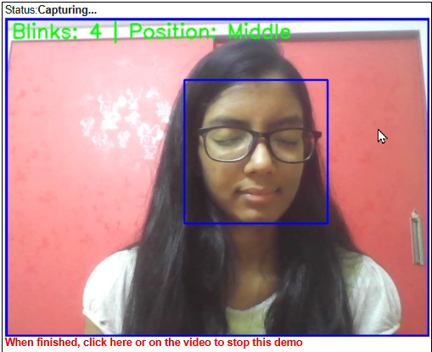
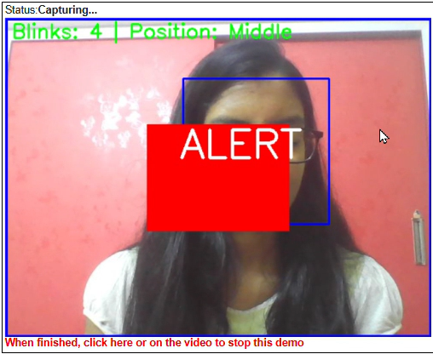
Results and Performance
This image illustrates the real-time processing pipeline of our system. The green and blue bounding boxes highlight the detected face and eyes
After Closing Eye for 1 mins
This image shows an example of an alert triggered by the system. A visual and auditory alert is presented to the driver, warning them of potential distraction.
Name : Shaili Sahu

Slide 8
Future Work and Challenges
Potential Improvements:
Enhanced Feature Extraction: Explore advanced techniques like attention mechanisms to improve feature extraction
Multimodal Fusion: Incorporate additional sensor data (e.g., heart rate, skin conductance) to enhance the accuracy of driver state detection.
Advanced Alert Systems: Implement more sophisticated alert mechanisms, such as haptic feedback or voice commands.
Interactive AR Heads-Up Display: Develop an interactive AR HUD to provide timely information and alerts without distracting the driver.
Name : Shaili Sahu

Slide 9
Future Work and Challenges
Challenges Encountered:
Data Collection and Annotation: Acquiring a large and diverse dataset of real-world driving scenarios can be challenging.
Robustness in Adverse Conditions: Ensuring the system's performance in challenging lighting conditions, weather, and environmental factors.
Ethical Considerations:
Privacy and Data Security: Implementing measures to protect user privacy and data security.
Bias and Fairness: Ensuring that the system is unbiased and fair across different demographics.
Human-AI Interaction: Designing the system to minimize distractions and enhance the overall driving experience.
Name : Shaili Sahu
Thank you ☺

Slide 10
Conclusion
Key Contributions:
Developed a robust AI-driven driver monitoring system capable of detecting fatigue, distraction, and other critical driver states.
Implemented a real-time pipeline for video processing, feature extraction, and model inference.
Designed a user-friendly interface for displaying alerts and feedback.

